Slide 1
Abstraction

Slide 2
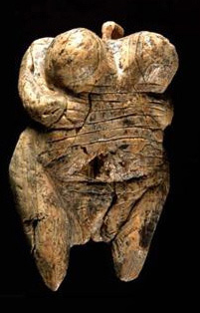
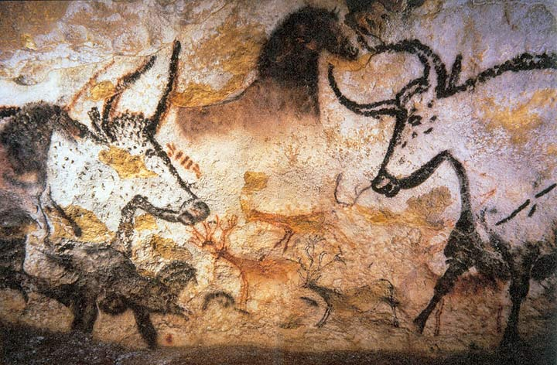
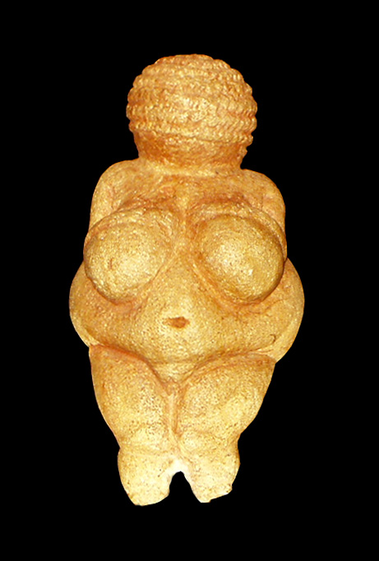
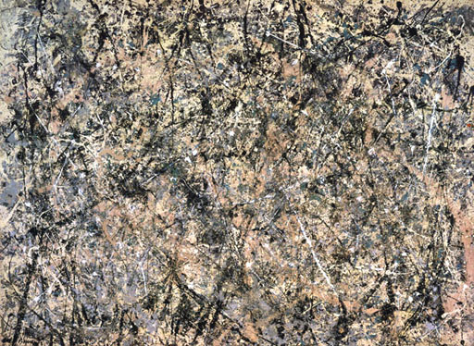
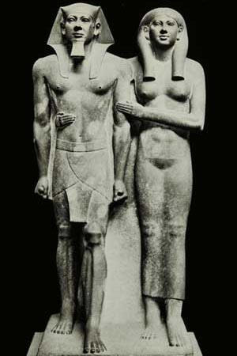
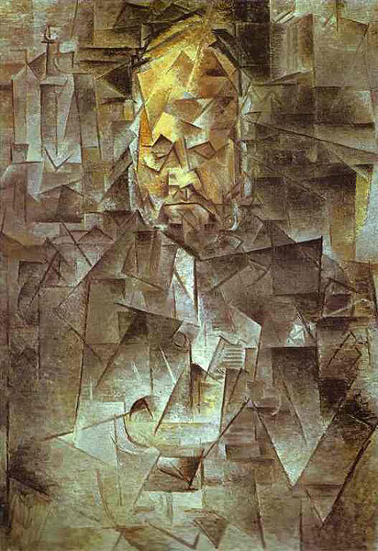
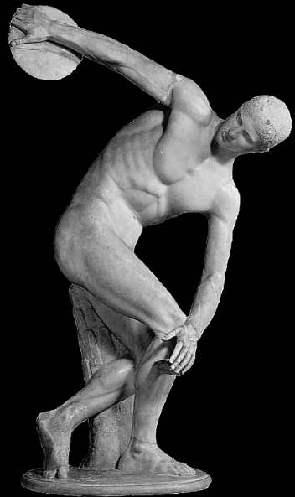
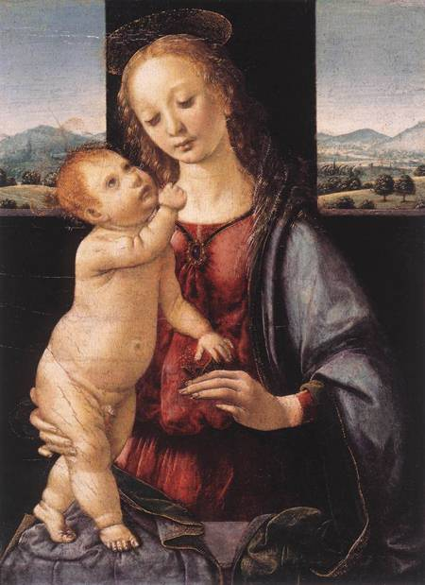
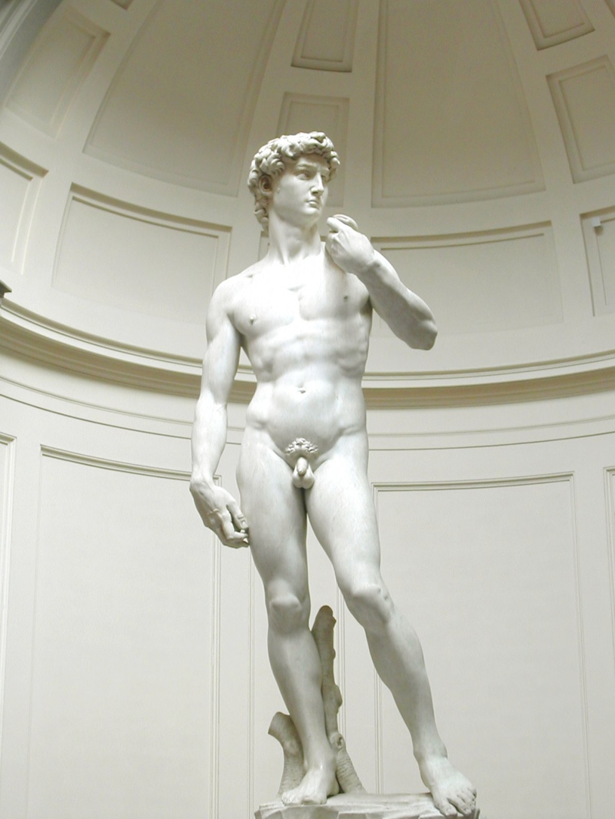

ART HISTORY (SO FAR)
Today
35,000 years ago
-20k
-16k
-4.5k
-2.5k
-1k
-60
-100
-500
Notes:
Before we begin with contemporary art, let's take a step back and look at some of the art that was made during the other 35,000 years of Art History. I'm not going to mention too many names because I don't want you to worry about remembering any artists this week, just the ideas behind the art.

Slide 3
next week:
Abstract Expressionism
and
Color Field Painting
Notes:
Next week we start our class learning about Abstract Expressionism and Color Field Painting, so I want to start by examining the words: "Abstract", "Expressionism", and "Color Field".

Slide 4
next week:
Abstract Expressionism
and
Color Field Painting
Notes:
Let's start with the word "abstract".

Slide 5
Figurative Abstraction
Representational Abstraction
Non-Representational Abstraction
Notes:
We will soon see there are many different types of abstraction out there, and while I don't want to just read off the definition of abstraction to you, I do want to take some time to examine three terms that are often used to describe abstraction: figurative abstraction, representational abstraction, and nonrepresentational abstraction.

Slide 6
Figurative
Abstraction
Non-Representational
Abstraction
Representational
Abstraction
Notes:
If we diagram these out we could say that representational and nonrepresentational abstraction are two separate spheres. And figurative abstraction is one type of representational abstraction.

Slide 7
Notes:
Figurative abstraction very simply put means abstraction that still references the idea of the human form, so most obviously a figure like this one...

Slide 8
Notes:
...or portraits like this one, would be considered figurative abstraction.

Slide 9
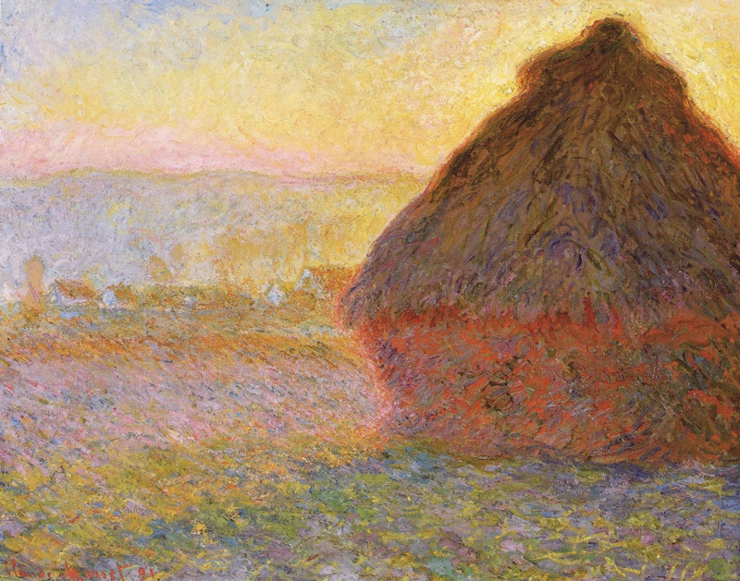
Notes:
Now a piece like this one, is not really concerned with figures so much as a landscape. This piece is still a representational piece so it would be considered representational abstraction, but not figurative abstraction.

Slide 10
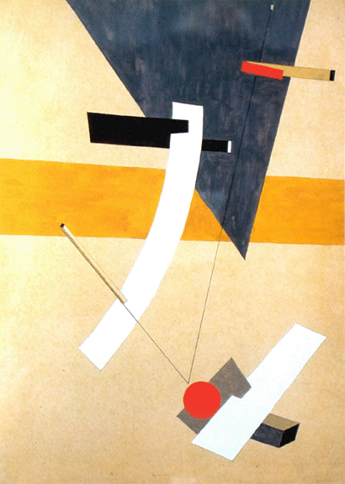
Notes:
On the other hand we can have pieces like this...

Slide 11
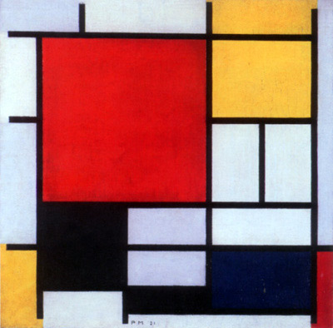
Notes:
...or this that aren't representing anything in the natural world. This is what we consider non-representational abstraction because it's interested less in describing a person or a tree, say, and more interested in exploring abstract ideas like color theory and composition.

Slide 12
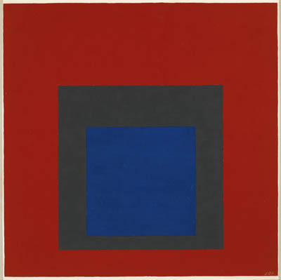
Notes:
Joseph Albers was one artist who was interested in focusing on how one color relates to another color, so many of his paintings are made of concentric square fields of color. Not only is nothing represented in this piece, but the only lines in the painting are those created when one field lays next to another.

Slide 13
next week:
Abstract Expressionism
and
Color Field Painting
Notes:
And here we get one of our definitions for next week for free, because this is exactly what the term "Color Field" is referring to.

Slide 14
Images:
Venus of Hohle Fels, 35-40,000 years old, Mamoth Ivory, Germany
Venus of Willendorf, 24-26,000 years old, limestone
Lascaux Caves, 16 thousand years old, France
King Mycerinus and Wife, 4,500 years old, Egypt
Discobolus, 2,500 years old, Greece
Leonardo Da Vinci, Madonna and Child with a Pomegranate, 1469, Italy
Michelangelo, David, 1501-1504, Italy
Edward Monet, Haystacks, 1891, France
Pablo Picasso, Vollard, 1910, France
El Lissitzky, Proun 12E, 1923, Russia
Piet Mondrian, Composition in Red, Yellow, Blue, 1931
Joseph Albers, Homage to the Square, 1950
Jackson Pollock, Lavender Mist, 1950, New York
Notes:
Venus of Hohle Fels, 35-40,000 years old, Mamoth Ivory, Germany
Venus of Willendorf, 24-26,000 years old, limestone
Lascaux Caves, 16 thousand years old, France
King Mycerinus and Wife, 4,500 years old, Egypt
Discobolus, 2,500 years old, Greece
Leonardo Da Vinci, Madonna and Child with a Pomegranate, 1469, Italy
Michelangelo, David, 1501-1504, Italy
Edward Monet, Haystacks, 1891, France
Pablo Picasso, Vollard, 1910, France
El Lissitzky, Proun 12E, 1923, Russia
Piet Mondrian, Composition in Red, Yellow, Blue, 1931
Joseph Albers, Homage to the Square, 1950
Jackson Pollock, Lavender Mist, 1950, New York

